Slide 1
Local Government Pension Schemes
Investing members’ money in death, destruction and climate catastrophe

Slide 2




Background to LGPS
SCHEME FOR LOCAL GOVT EMPLOYEES +
FULLY FUNDED SCHEME (CONTRIBUTIONS + INVESTMENTS)
TOTAL VALUE OF £391.5 BN
6.7 MILLION MEMBERS

Slide 3
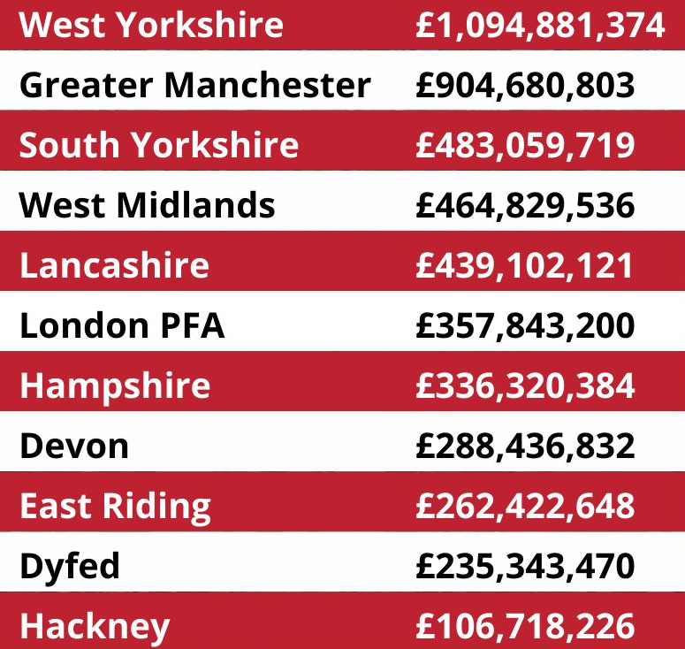
National picture
Top 10 LGPS investors in Israeli genocide and apartheid
(source and image: PSC)

Slide 4
Divestment “successes”
July ’24 | Waltham Forest, Islington
Sept ’24 | Lewisham
Nov ‘24 | Manchester, Trafford
Jan ’25 | Bristol, Tower Hamlets
Feb ’25 | Sheffield, North Somerset

Slide 5
SYPA
179 903 scheme members
Assets of c.£11bn
130-150% funded
c.£255.7m investment in fossil fuels (2.3% of total fund)
c.£108m investments in defence companies (1% of total fund)
£4.8m invested in Israel (0.04% of fund), incl. £1.4 in govt bonds
Investments in Israel, defence and fossil fuels total just 3.3% of fund

Slide 6
Challenges
Fiduciary duty
“Responsible” Investment
Divestment vs Engagement
Pension pooling

Slide 7
Fiduciary duty
Fiduciary duty: decisions can only be made to maximise assets OR leave your conscience, ethics, morals (and belief in science) at the door
Scheme Advisory Board legal opinions.
Pension pooling

Slide 8
“Responsible” Investment
Fiduciary duty: decisions can only be made if in narrow financial interest of scheme members OR leave your conscience, ethics and morals at the door
Scheme Advisory Board legal opinions.
Divestment vs Engagement
Pension pooling

Slide 9
Divestment vs engagement
Fiduciary duty: decisions can only be made if in narrow financial interest of scheme members OR leave your conscience, ethics and morals at the door
Scheme Advisory Board legal opinions.
Divestment vs Engagement
Pension pooling

Slide 10
Pension pooling
Government has mandated further pooling with each pool to have minimum assets of over £100bn
Investment decisions to be made by pools
Investment advice to be provided by pool
LGPS to set asset allocation and have high level strategy statement only

Slide 11
What can we do?
Scrutiny, scrutiny, scrutiny
Be a conscientious objector and be vocal about it
Use climate impact to get round fiduciary duty
International law - government is not going to respond to SAB re: PSC letter.

Slide 12

Resources
Waltham Forest Divestment Guide: https://drive.google.com/file/d/1be2pTaUZIo7OWxmzQzwRSL1OIfrcAU5J/view?usp=drive_link
Greens 4 Palestine: Advice from Cllrs & activists
Unison Toolkit: https://lgpsdivest.org/wp-content/uploads/2020/12/Unison-Pensions-Pack.pdf
PSC guide: https://lgpsdivest.org/wp-content/uploads/2024/10/The-Local-Government-Pension-Scheme-A-Campaigners-Guide-Public.pdf

